Slide 1
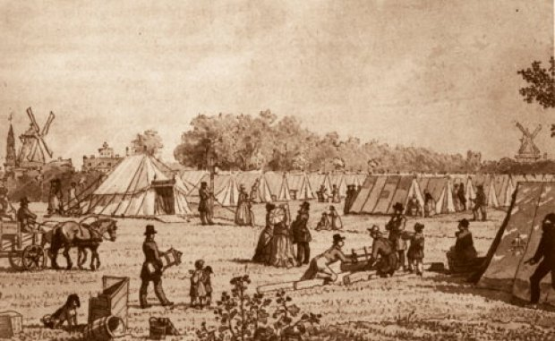
Cholera in Copenhagen, 1853
Matthew Phelps
PhD Fellow
Faculty of Health

Slide 2
Why study a 1853 outbreak?
Data rich environment
Contemporary outbreaks can be data poor by comparison
No previous cholera in CPH – no acquired immunity
Potential to address research gaps in understanding of contemporary cholera outbreaks

Slide 3

Possibility for exposure to similar risk factors as in Bangladesh peri-urban informal settlements
BUT
Avoid lazy comparisons

Slide 4
Reproductive number
R₀: Number of secondary cases one infectious case will cause in an entirely susceptible population
Predicts severity of outbreak
predicts proportion of population needing vaccination
R_{ef} Effective number of secondary cases one infectious case causes during as a specified point in the course of an outbreak
Monitor temporal patterns in transmission potential
Monitor effects of control measure during course of epidemic

Slide 5
Types of models
Mass action-based models
Assumes homogenously mixing population and uniform hazard exposure
Often used for cholera
Evidence that assumption of homogeneity is flawed (super-spreaders)
Infection-network approaches
Used in STI modeling
Allows for super-spreaders

Slide 6
Previous work
Zimbabwe R₀ estimation (Mukandavire et al. 2011)
From 1.11 – 2.72
Estimates from regional-level data
Haiti 2010 (Chunara et al. 2010)
1.06 – 3.72
Estimates from regional / national-level data
Heterogeneity within Dhaka (King et al. 2005)
John Snow

Slide 7
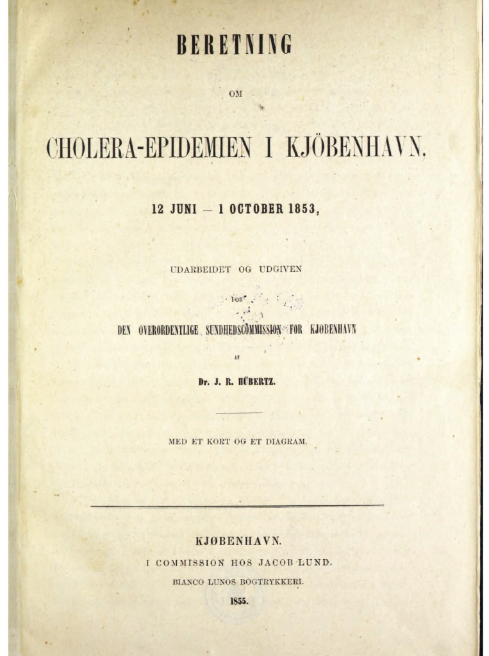
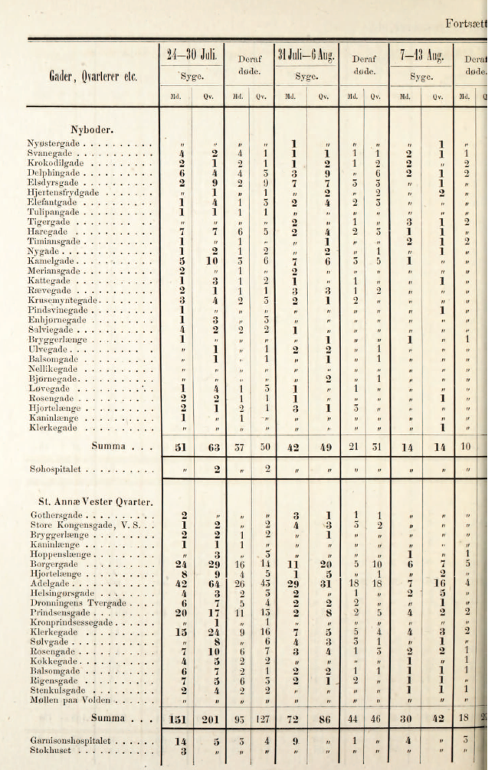

Slide 8
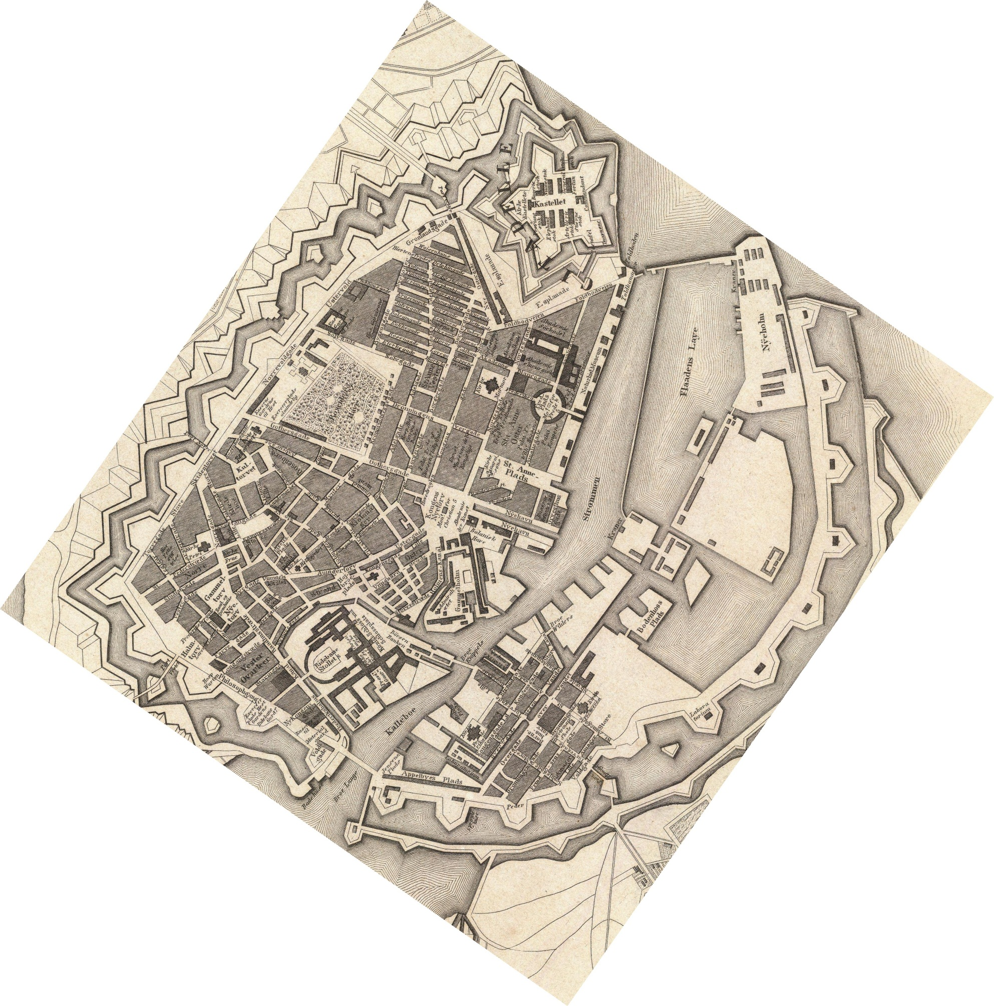

Slide 9
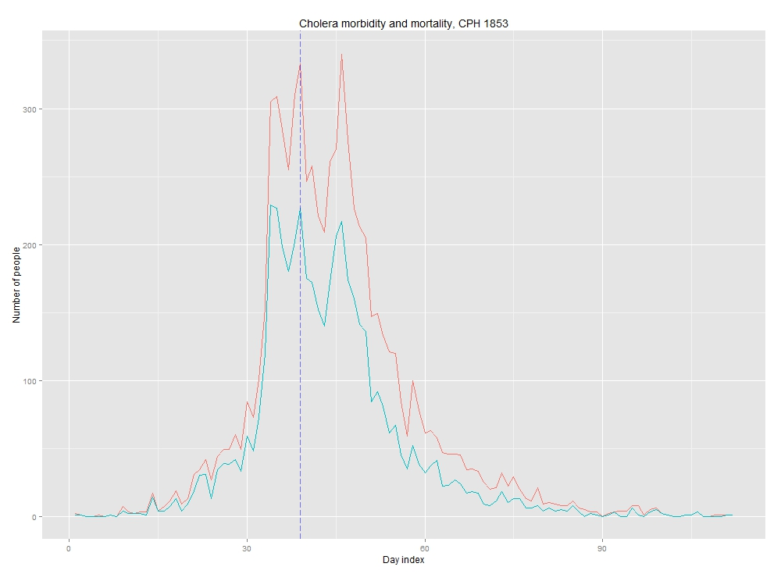

Slide 10
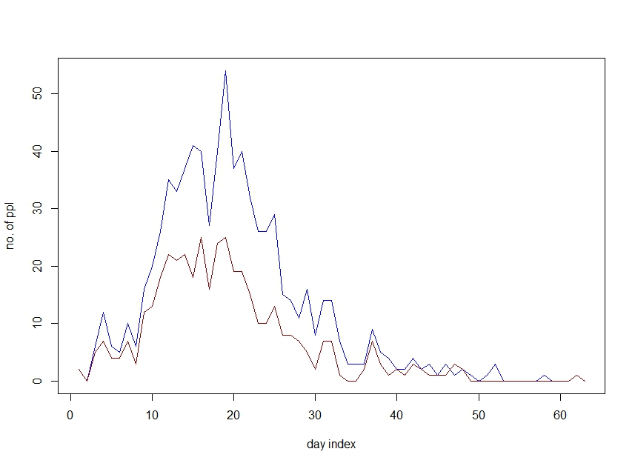

Slide 11

Explore epidemic temporally
Wallinga & Tunis 2004
Notes:
The relative likelihood that case i has been
infected by case j is then the likelihood that case i has been
infected by case j, normalized by the likelihood that case i
has been infected by any other case k:
The effective reproduction number for case j is the sum over
all cases i, weighted by the relative likelihood that case i has
been infected by case j

Slide 12
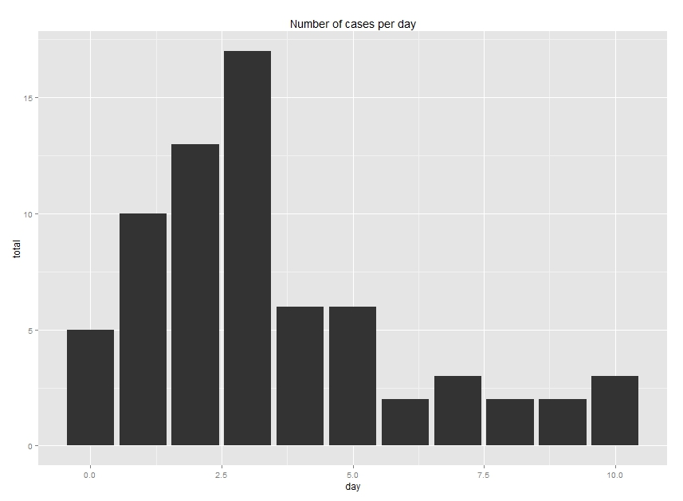
Serial interval estimation
Mosley, W.H., et al., The relationship of vibriocidal antibody titre to susceptibility to cholera in family contacts of cholera patients. Bull World Health Organ, 1968. 38(5): p. 777-85.

Slide 14
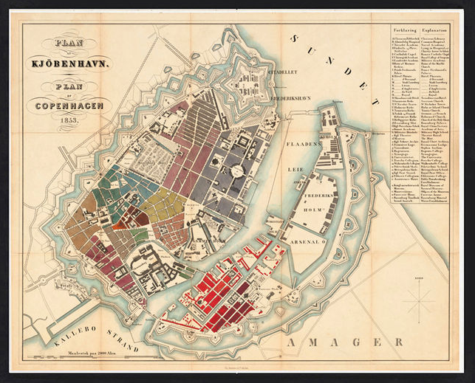
Explore epidemic spatially

Slide 16
Notes:
Data not normalized

Slide 17
Reproductive numbers

Slide 18
Conclusions (tentative)
Epidemic is qualitatively and quantitatively different when compared at city vs. neighborhood level
Multiple separate epidemic peaks
Each neighborhood has only one epidemic peak
Estimations from regional/national level data are problematic
Limited utility of mass action models for Cholera

Slide 19
Limitations
Spatial data only available on a weekly basis – yet serial interval is ~3 days
Cannot examine R_{ef} at neighborhood or street level
No data on asymptomatic cases
Small N in several neighborhoods

Slide 20
Future work
Explore temporal-spatial structure at street level
Compare age-structure of data to other cities (immunity) (?)
Simulation-based testing of R_{ef} values
Test relative strength of alternative transmission pathways
Notes:
Link to Bangladesh: King’s paper shoing highly heterogenaouty in Dhaka

